Slide 1



by Miquel R. and Roger H.
KRYPTIA
KRYPTIA
music by DJ Tropiguay
@tropiguay

Slide 2

You are an interstellar traveler in a world where something called Earth is the last touristic call.
But there is a problem: as people from all over the galaxy gather there, nobody understands anybody.
So, in order to understand what they are saying from this extremely interesting place called “Earth”, you need to decipher what they are saying!
Gather some friends to join you in this planet, and try to find out who is the quicker decipher.
Welcome to…
KRYPTIA
KRYPTIA

Slide 3
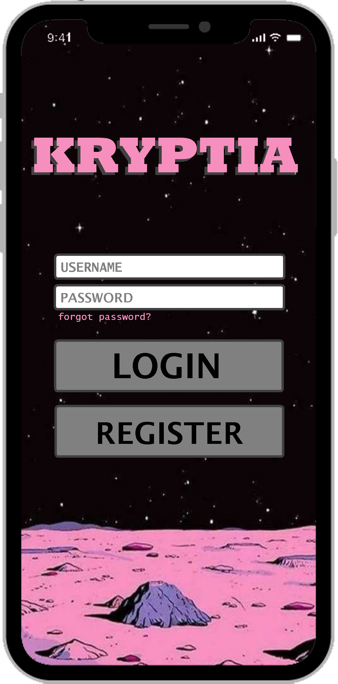
Overview
KRYPTIA is a multiplayer competitive educational game for Android or IOS in which participants challenge each other to prove who is the one able to decipher hidden words quicker.
KRYPTIA is a tool that empowers teachers that want to introduce cybersecurity and cyphration to children in a fun and proactive way.

Slide 4
Login Page
Basic username – password
Checking with the main data base

Slide 5
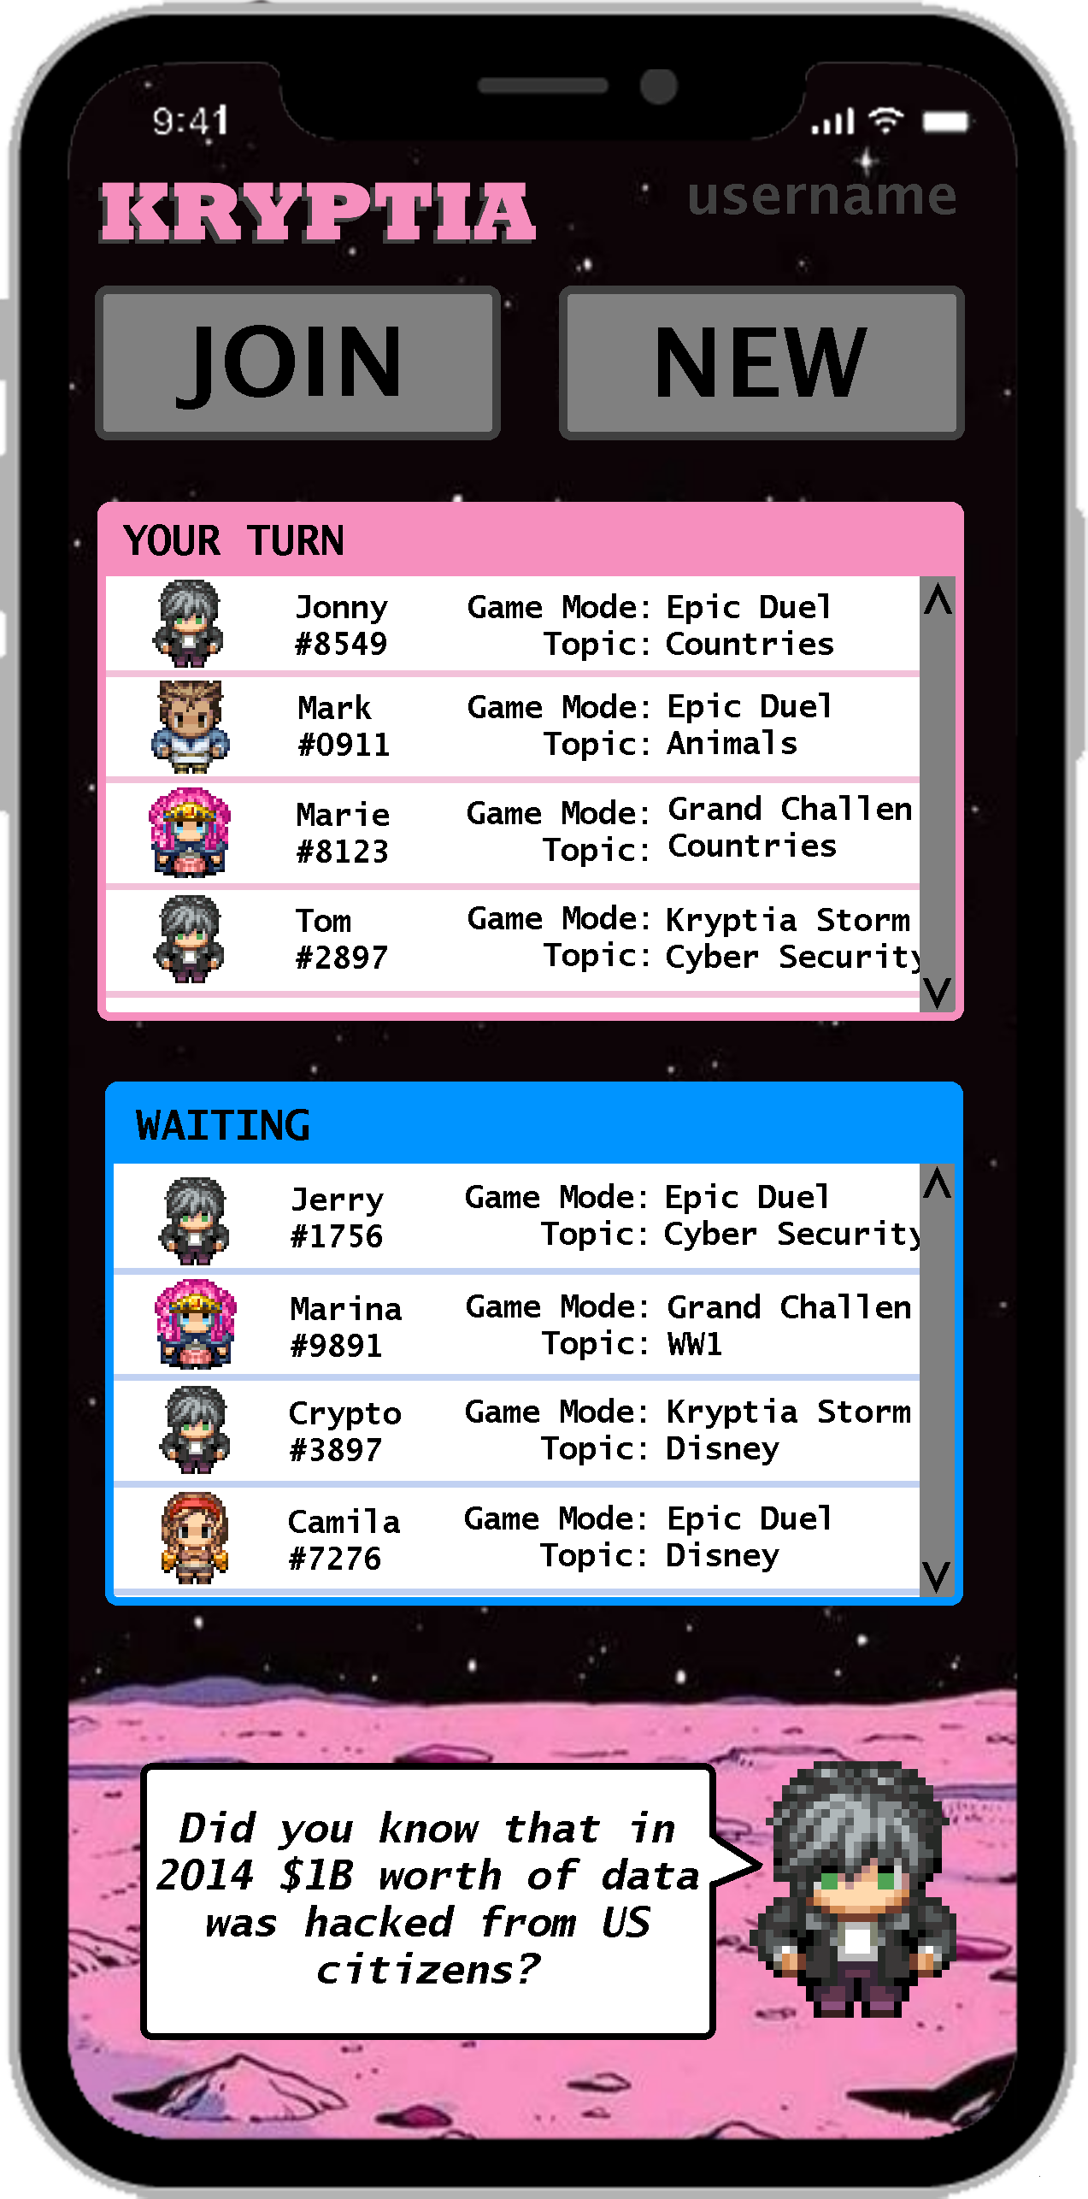
Main Menu
See your stats.

Slide 6
Main Menu
See your stats.
Start a new Game

Slide 7
Main Menu
See your stats.
Start a new Game
Enter a started game

Slide 8
Main Menu
See your stats.
Start a new Game
Enter a started game
Continue playing a game you had already started

Slide 9
Main Menu
See your stats.
Start a new Game
Enter a started game
Continue playing a game you had already started
See the progress in a game you have finished playing, but need to wait for other players

Slide 10
Main Menu
Change your avatar!!

Slide 11
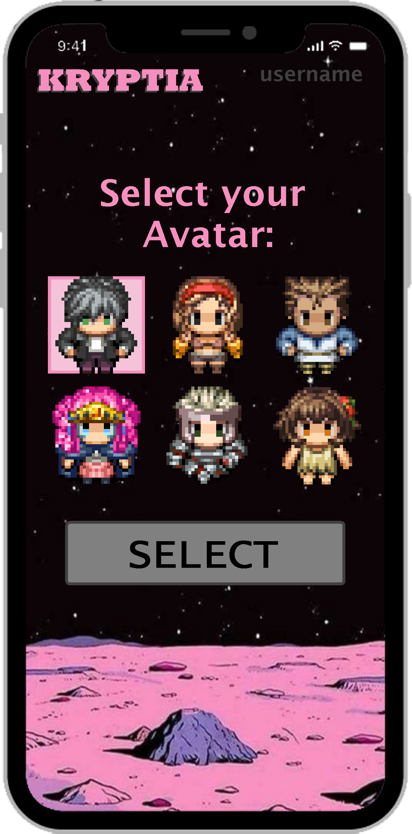
Main Menu
Change your avatar!!

Slide 12
Main Menu
Change your avatar!!

Slide 13
Main Menu
Let’s create a new one!

Slide 14
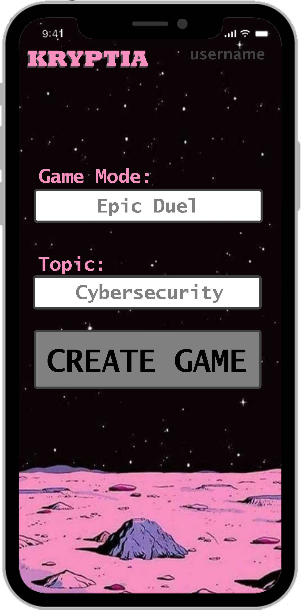
Create a New Game
You can choose between 3 modes:
Epic Duel (1 vs 1)
Kryptia Storm (All vs All)
Grand Challenge (Educational mode)

Slide 15
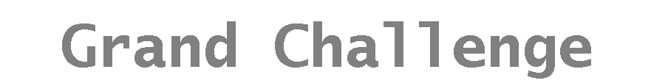
Create a New Game
You can choose between 3 modes:
Epic Duel (1 vs 1)
Kryptia Storm (All vs All)
Grand Challenge (Educational mode)
Notes:
1) Duel Challenge: In this game mode you play a quick match of a random topic against a friend.
2) Kryptia Storm: In this game mode there is one person that designs one challenge and the other people join the room (upt to 10 people). Then, asynchronously, people complete the 10 questions on the topic. The one with more points win.
3) Class mode: In this last game mode, the teacher can control all aspects of the challenge Controlling the 3 categories of each question, and even making its own ones! The point is that on that class they would have been taught how to solve it and the reward could be either a class ranking or the ones who finish can go to the playground so the faster you solve the challenge the more play time you get.

Slide 16
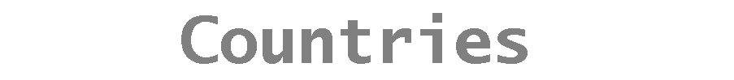
Create a New Game
You can choose between 3 modes:
Epic Duel (1 vs 1)
Kryptia Storm (All vs All)
Grand Challenge (Educational mode)
You can choose between 200 topics:
Countries
WWI
Cybersecurity
…and much more!

Slide 17
How a Game Works?
10 questions
5 cyphered sentences
Shift
Shift + Reverse
Number
Number + Reverse
Symbols
5 cyphered numbers
Shift
Hexadecimal
Binary
R
A
N
D
O
M

Slide 18
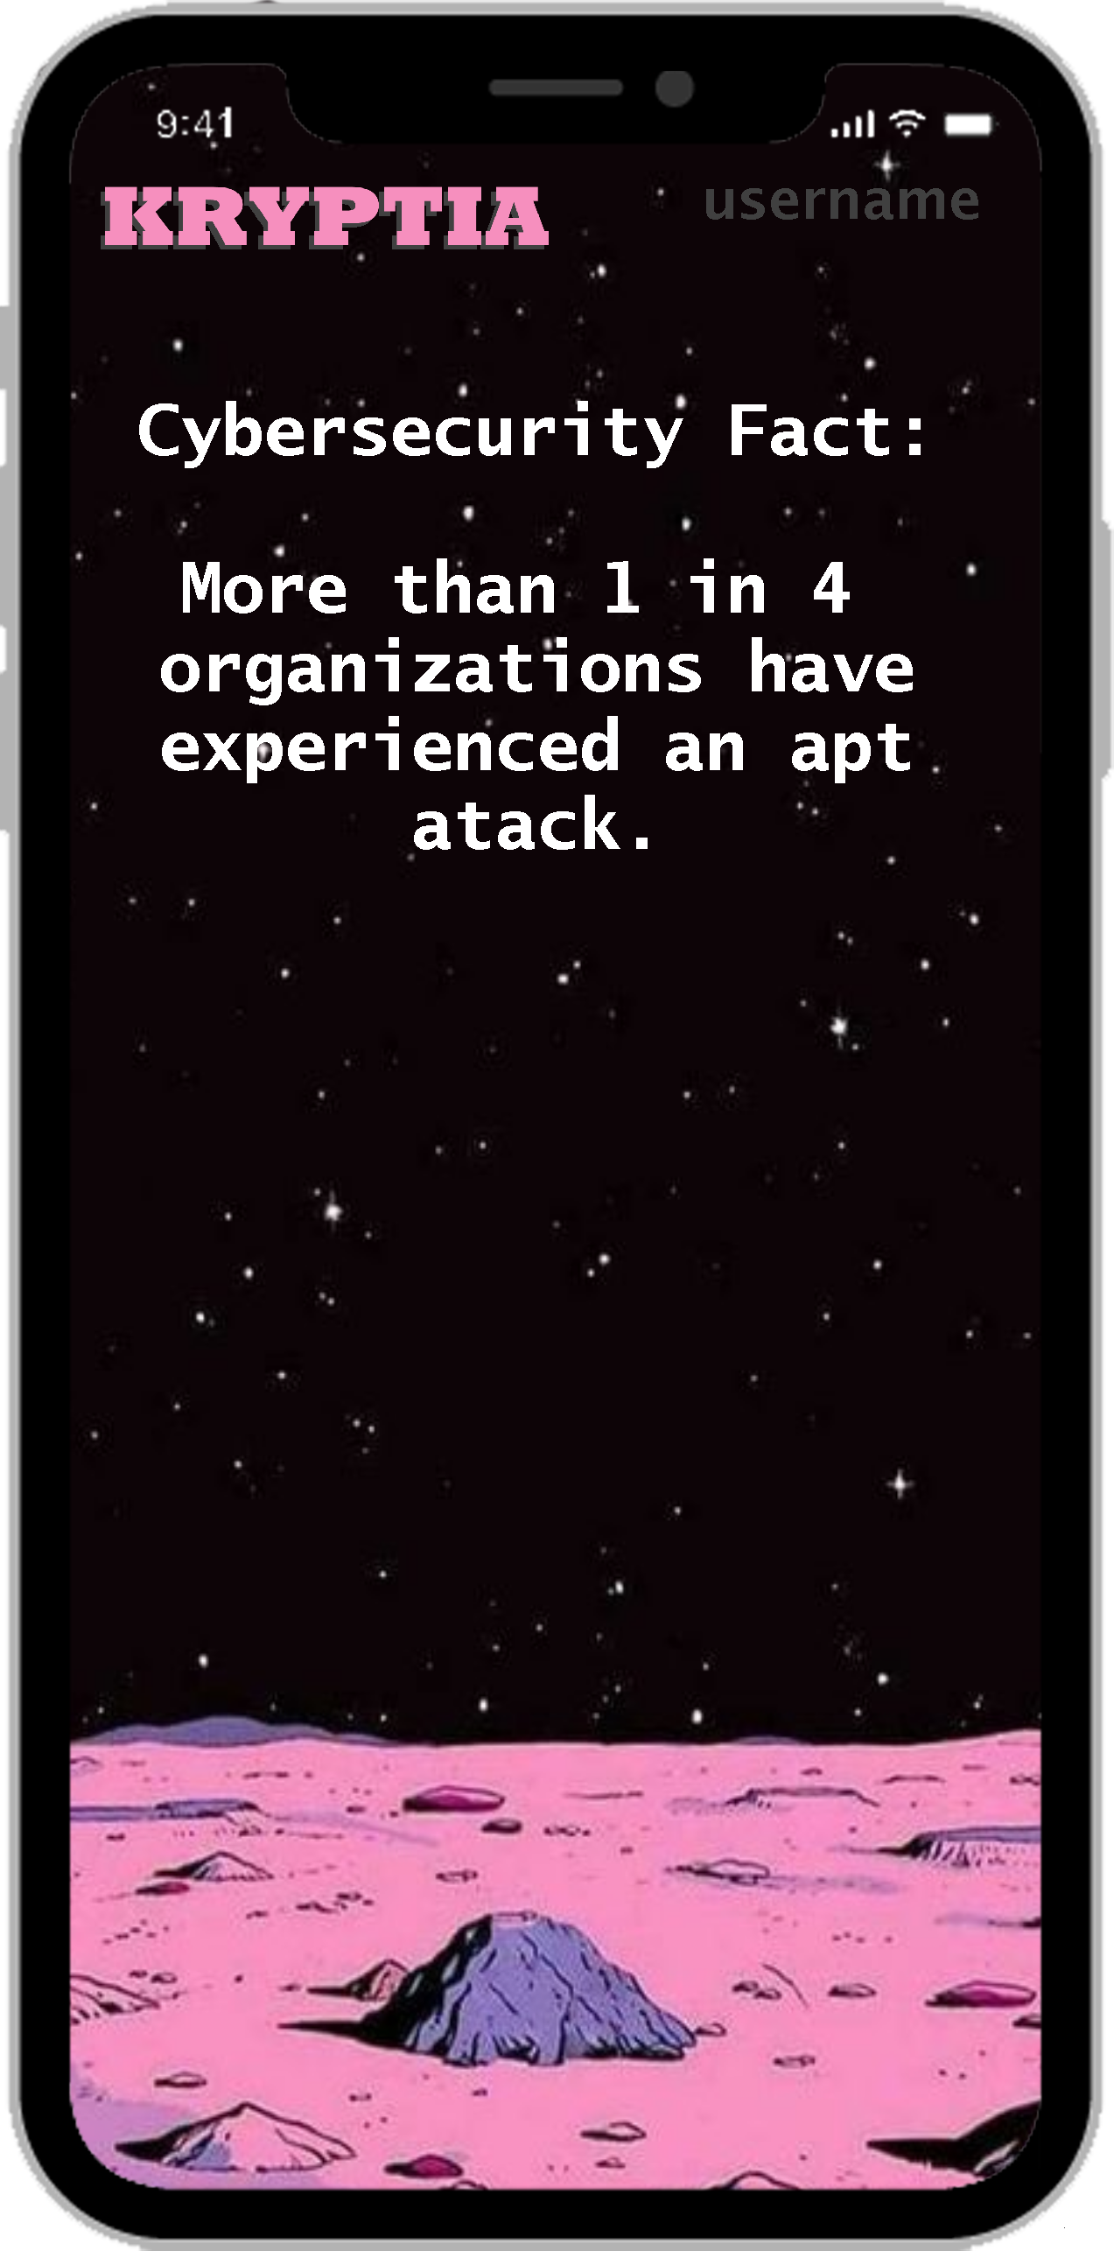
More cyber-facts!!
Database full of cybersecurity facts that players will read before the game starts.

Slide 19
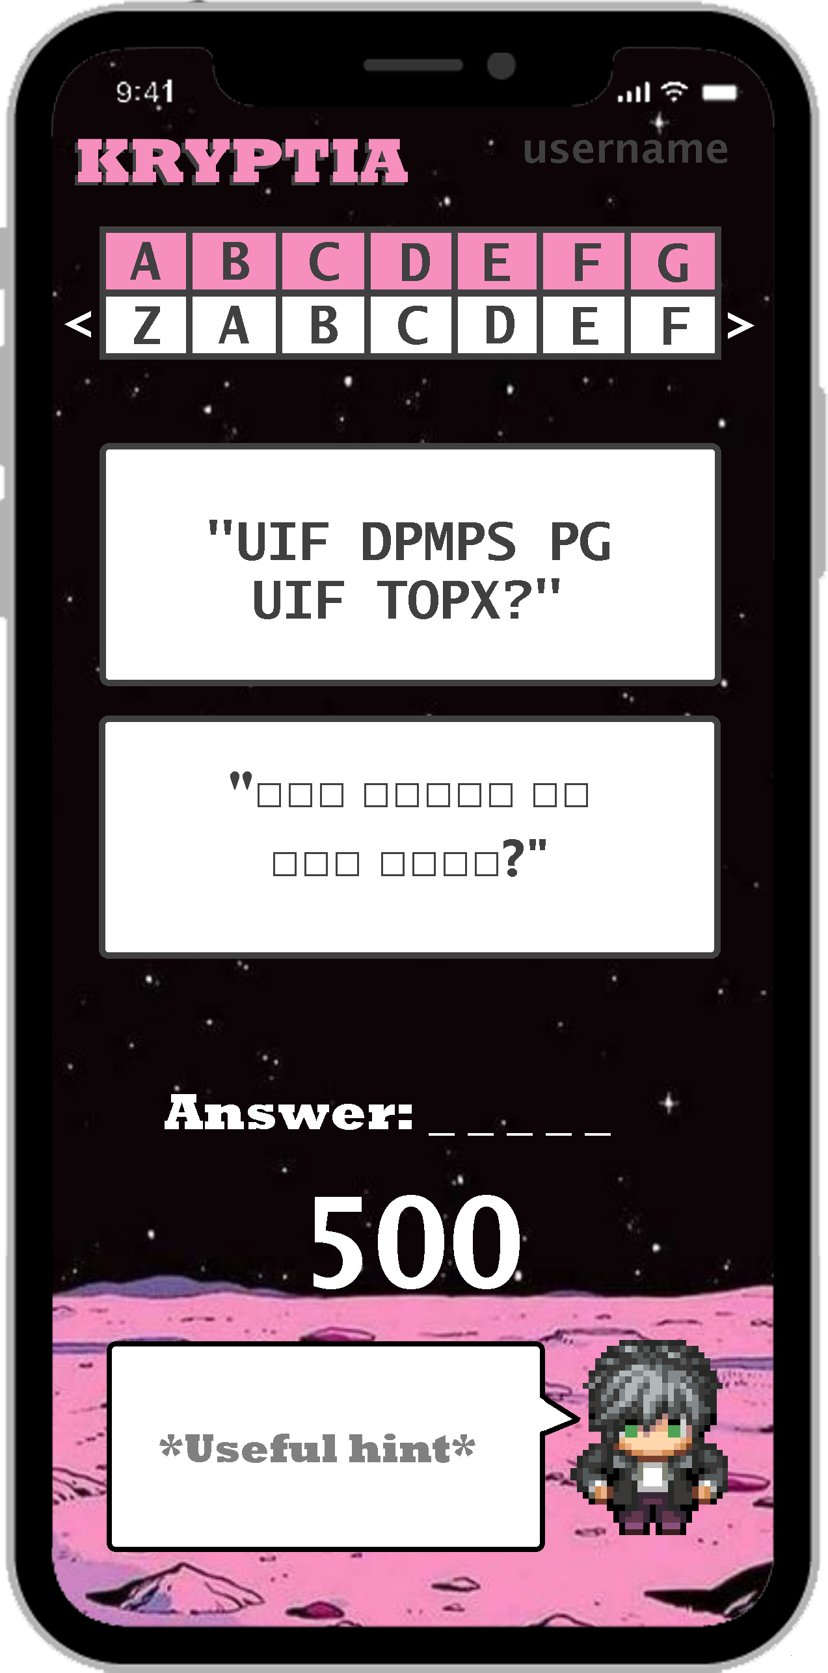
The Game Experience
Sentence with shift

Slide 20

The Game Experience
Alphabet Ruler

Slide 21

The Game Experience
Alphabet Ruler

Slide 22
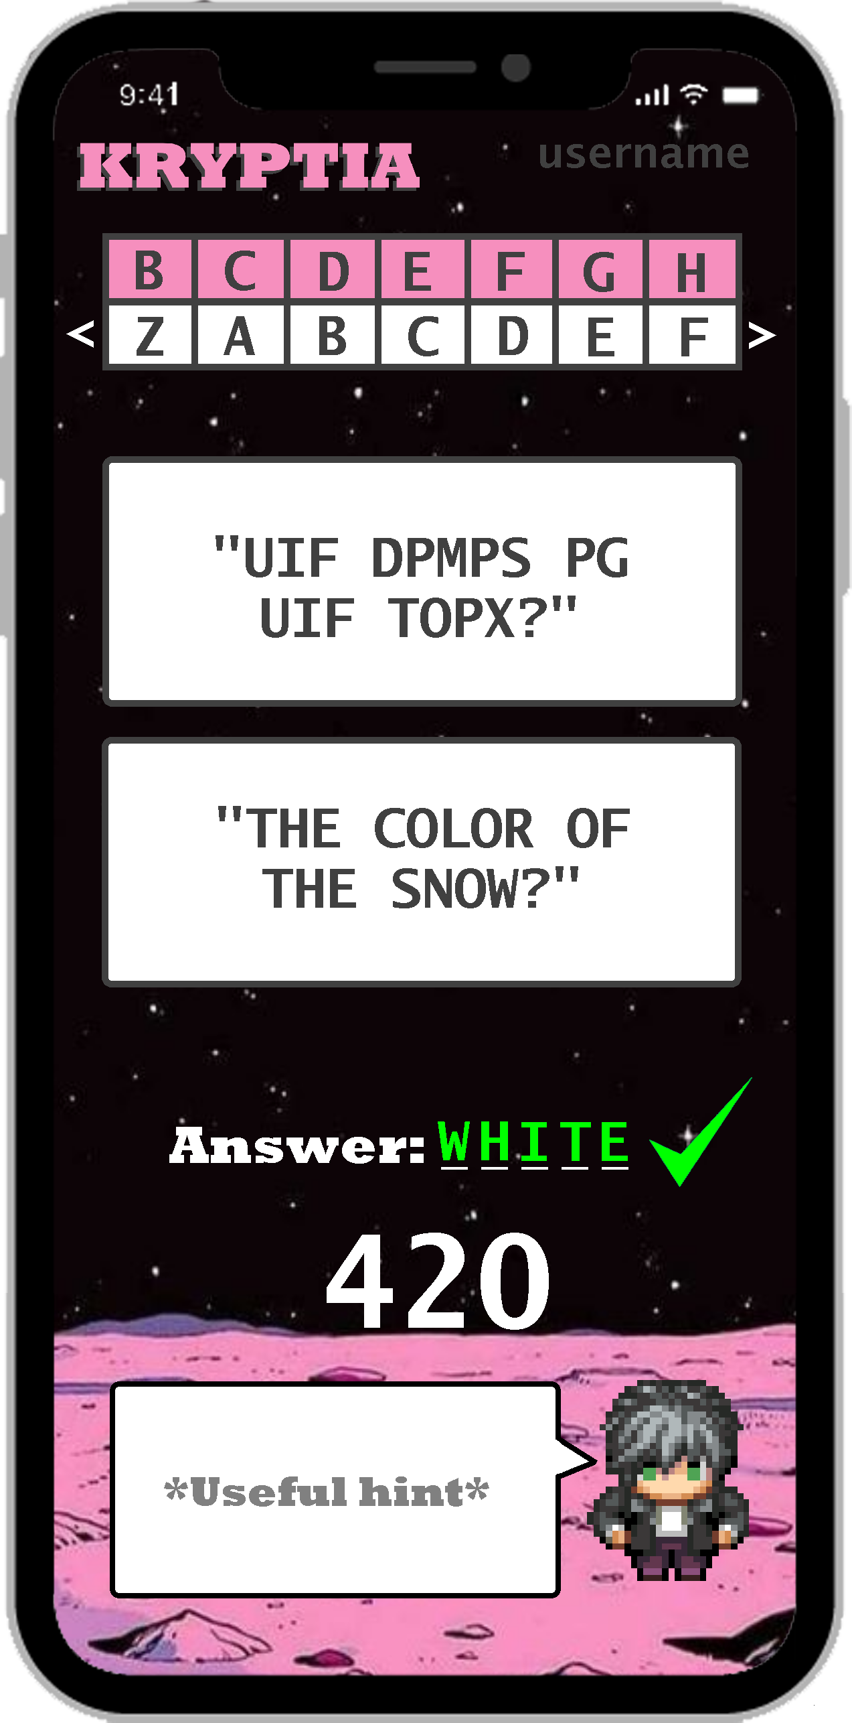
The Game Experience

Slide 23
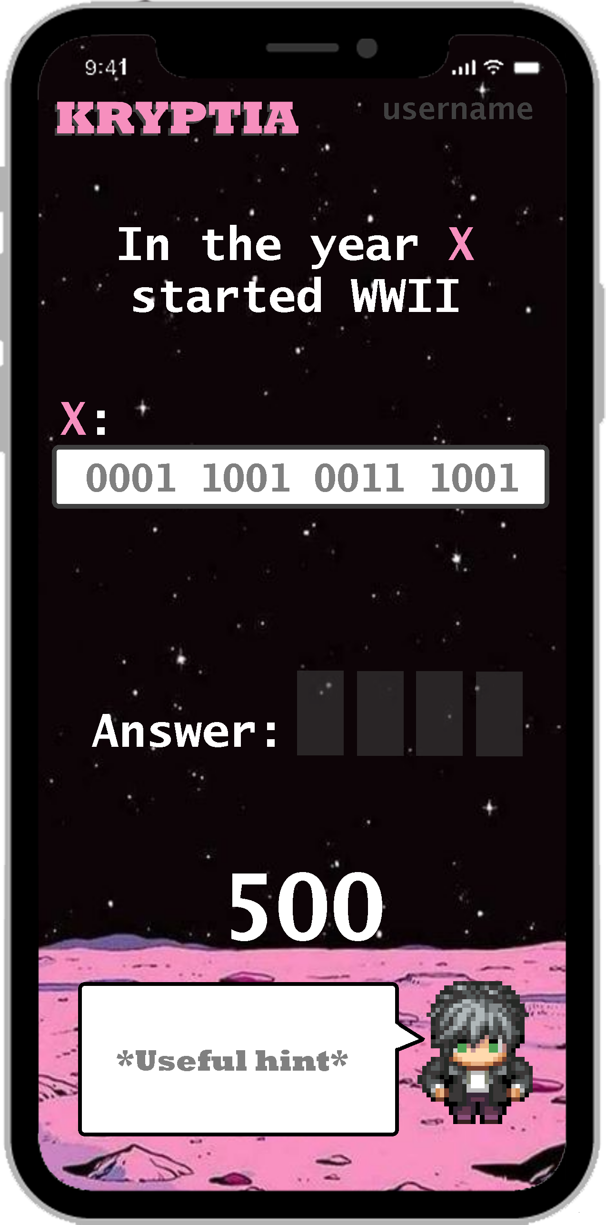
The Game Experience
Number with binary code

Slide 24
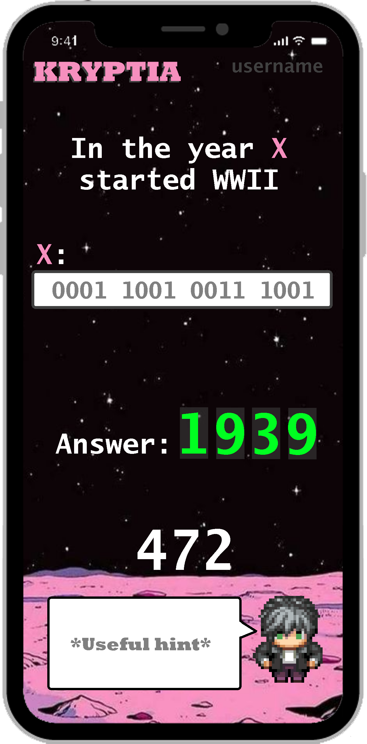
The Game Experience
Number with binary code

Slide 25
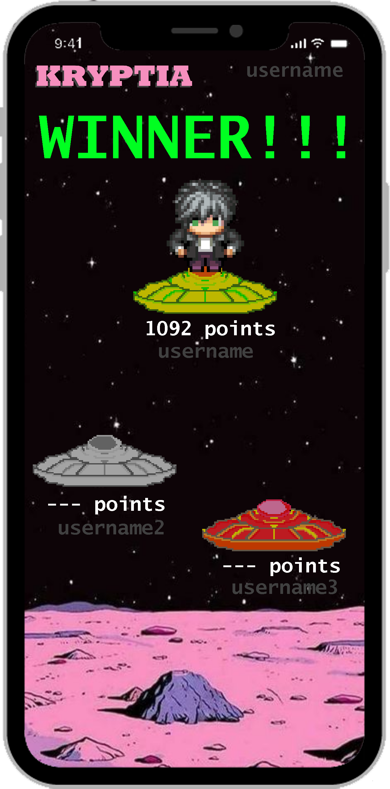
Congratulations!!!
Yeap, surprisingly you won against…. nobody

Slide 26
Point Mechanics
500 points - 1 point per second left
-20 points if you can’t solve in 500 sec
100 points if you are first
80 points if you are second
60 points if you are third
Max Points per Game: 6000 pts
Min Points per Game: 0 pts

Slide 27
Achivements
First Win
5 Wins
5 Wins in a Row
First Loss
First [insertGameMode] completed
First [insertGameMode] won
2 Days gaming in a row!
5 days in a row playing!
7 days in a row winning!
Top % of your zone.
….

Slide 28
What is learned?
User Centered Objectives
Motivate children to independently learn basic encrypting skills
Teach children about US cybersecurity current situation and challenges.
Help teachers to teach basic mathematical conversions (alphabet, decimal, binary, hexadecimal) in a participative and enjoyable way.
Provide tools to teachers that want to rise cybersecurity awareness to their pupils.
Skills Learned by Users
Ability to make critical observations.
Extract important information and patterns.
Understand the basic cyphration techniques
Capability to solve abstract problems.

Slide 29
Miquel R. Roger H. DJ Tropiguay
See you soon at . . .
KRYPTIA
KRYPTIA

